Slide 1
The Foundations: Logic and Proofs
Chapter 1, Part II: Predicate Logic

Slide 2
Summary
Predicate Logic (First-Order Logic (FOL), Predicate Calculus)
The Language of Quantifiers
Logical Equivalences
Nested Quantifiers
Translation from Predicate Logic to English
Translation from English to Predicate Logic

Slide 3
Predicates and Quantifiers
Section 1.4

Slide 4
Section Summary
Predicates
Variables
Quantifiers
Universal Quantifier
Existential Quantifier
Negating Quantifiers
De Morgan’s Laws for Quantifiers
Translating English to Logic
Logic Programming (optional)

Slide 5
Propositional Logic Not Enough
If we have:
“All men are mortal.”
“Socrates is a man.”
Does it follow that “Socrates is mortal?”
Can’t be represented in propositional logic. Need a language that talks about objects, their properties, and their relations.
Later we’ll see how to draw inferences.

Slide 6
Introducing Predicate Logic
Predicate logic uses the following new features:
Variables: x, y, z
Predicates: P(x), M(x)
Quantifiers (to be covered in a few slides):
Propositional functions are a generalization of propositions.
They contain variables and a predicate, e.g., P(x)
Variables can be replaced by elements from their domain.

Slide 7
Propositional Functions
Propositional functions become propositions (and have truth values) when their variables are each replaced by a value from the domain (or bound by a quantifier, as we will see later).
The statement P(x) is said to be the value of the propositional function P at x.
For example, let P(x) denote “x > 0” and the domain be the integers. Then:
P(-3) is false.
P(0) is false.
P(3) is true.
Often the domain is denoted by U. So in this example U is the integers.

Slide 8
Examples of Propositional Functions
Let “x + y = z” be denoted by R(x, y, z) and U (for all three variables) be the integers. Find these truth values:
R(2,-1,5)
Solution: F
R(3,4,7)
Solution: T
R(x, 3, z)
Solution: Not a Proposition
Now let “x - y = z” be denoted by Q(x, y, z), with U as the integers. Find these truth values:
Q(2,-1,3)
Solution: T
Q(3,4,7)
Solution: F
Q(x, 3, z)
Solution: Not a Proposition

Slide 9
Compound Expressions
Connectives from propositional logic carry over to predicate logic.
If P(x) denotes “x > 0,” find these truth values:
P(3) ∨ P(-1) Solution: T
P(3) ∧ P(-1) Solution: F
P(3) → P(-1) Solution: F
P(3) → P(1) Solution: T
Expressions with variables are not propositions and therefore do not have truth values. For example,
P(3) ∧ P(y)
P(x) → P(y)
When used with quantifiers (to be introduced next), these expressions (propositional functions) become propositions.

Slide 10
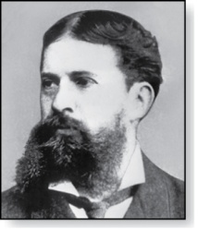
Quantifiers
Charles Peirce (1839-1914)
We need quantifiers to express the meaning of English words including all and some:
“All men are Mortal.”
“Some cats do not have fur.”
The two most important quantifiers are:
Universal Quantifier, “For all,” symbol: ∀
Existential Quantifier, “There exists,” symbol: ∃
We write as in ∀x P(x) and ∃x P(x).
∀x P(x) asserts P(x) is true for every x in the domain.
∃x P(x) asserts P(x) is true for some x in the domain.
The quantifiers are said to bind the variable x in these expressions.

Slide 11
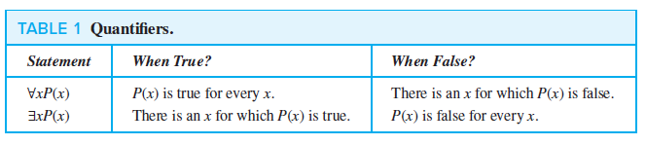
Quantifiers
Universal Quantifier, “For all,” symbol: ∀
Existential Quantifier, “There exists,” symbol: ∃

Slide 12
Universal Quantifier
∀x P(x) is read as “ For all x, P(x)” or “For every x, P(x)”
Examples:
If P(x) denotes “x > 0” and U is the integers, then ∀x P(x) is false.
If P(x) denotes “x > 0” and U is the positive integers, then ∀x P(x) is true.
If P(x) denotes “x is even” and U is the integers, then ∀ x P(x) is false.

Slide 13
Existential Quantifier
∃x P(x) is read as “For some x, P(x)”, or as “There is an x such that P(x),” or “For at least one x, P(x).”
Examples:
If P(x) denotes “x > 0” and U is the integers, then ∃x P(x) is true. It is also true if U is the positive integers.
If P(x) denotes “x < 0” and U is the positive integers, then ∃x P(x) is false.
If P(x) denotes “x is even” and U is the integers, then ∃x P(x) is true.

Slide 14
Uniqueness Quantifier (optional)
∃!x P(x) means that P(x) is true for one and only one x in the universe of discourse.
This is commonly expressed in English in the following equivalent ways:
“There is a unique x such that P(x).”
“There is one and only one x such that P(x)”
Examples:
If P(x) denotes “x + 1 = 0” and U is the integers, then ∃!x P(x) is true.
But if P(x) denotes “x > 0,” then ∃!x P(x) is false.

Slide 15
Thinking about Quantifiers
When the domain of discourse is finite, we can think of quantification as looping through the elements of the domain.
To evaluate ∀x P(x) loop through all x in the domain.
If at every step P(x) is true, then ∀x P(x) is true.
If at a step P(x) is false, then ∀x P(x) is false and the loop terminates.
To evaluate ∃x P(x) loop through all x in the domain.
If at some step, P(x) is true, then ∃x P(x) is true and the loop terminates.
If the loop ends without finding an x for which P(x) is true, then ∃x P(x) is false.
Even if the domains are infinite, we can still think of the quantifiers this fashion, but the loops will not terminate in some cases.

Slide 16
Properties of Quantifiers
The truth value of ∃x P(x) and ∀ x P(x) depend on both the propositional function P(x) and on the domain U.
Examples:
If U is the positive integers and P(x) is the statement “x < 2”, then ∃x P(x) is true, but ∀ x P(x) is false.
If U is the negative integers and P(x) is the statement “x < 2”, then both ∃x P(x) and ∀ x P(x) are true.
If U consists of 3, 4, and 5, and P(x) is the statement “x > 2”, then both ∃x P(x) and ∀ x P(x) are true. But if P(x) is the statement “x < 2”, then both ∃x P(x) and ∀ x P(x) are false.

Slide 17
Precedence of Quantifiers
The quantifiers ∀ and ∃ have higher precedence than all the logical operators.
For example, ∀x P(x) ∨ Q(x) means (∀x P(x))∨ Q(x)
∀x (P(x) ∨ Q(x)) means something different.
Unfortunately, often people write ∀x P(x) ∨ Q(x) when they mean ∀ x (P(x) ∨ Q(x)).

Slide 18
Translating from English to Logic
Example 1: Translate the following sentence into predicate logic: “Every student in this class has taken a course in Java.”
Solution:
First decide on the domain U.
Solution 1: If U is all students in this class, define a propositional function J(x) denoting “x has taken a course in Java” and translate as ∀x J(x).
Solution 2: But if U is all people, also define a propositional function S(x) denoting “x is a student in this class” and translate as ∀x (S(x)→ J(x)).
∀x (S(x) ∧ J(x)) is not correct. What does it mean?
Notes:
If we change the domain to consist of all people, we will need to express our statement as
“For every person x, if person x is a student in this class then x has studied java.”
If S(x) represents the statement that person x is in this class, we see that our statement can be expressed as ∀x(S(x) → J(x)). [Caution! Our statement cannot be expressed as ∀x(S(x) ∧ J(x)) because this statement says that all people are students in this class and have studied java!]

Slide 19
For example,
we may be interested in a wider group of people than only those in this class. If we change the domain to consist of all people, we will need to express our statement as
“For every person x, if person x is a student in this class then x has studied Java.”
If S(x) represents the statement that person x is in this class, we see that our statement can be expressed as ∀x(S(x) → J(x)).
[Caution! Our statement cannot be expressed as ∀x(S(x) ∧ J(x)) because this statement says that all people are students in this class and have studied
Java!]

Slide 20
Translating from English to Logic
Example 2: Translate the following sentence into predicate logic: “Some student in this class has taken a course in Java.”
Solution:
First decide on the domain U.
Solution 1: If U is all students in this class, translate as
∃x J(x)
Solution 1: But if U is all people, then translate as ∃x (S(x) ∧ J(x))
∃x (S(x)→ J(x)) is not correct. What does it mean?
Notes:
if we are interested in people other than those in this class, we look at the statement a little differently. Our statement can be expressed as
“There is a person x having the properties that x is a student in this class and x has Studied Java.”
In this case, the domain for the variable x consists of all people. We introduce S(x) to represent “x is a student in this class.” Our solution becomes ∃x(S(x) ∧ J(x)) [Caution! Our statement cannot be expressed as ∃x(S(x) → J(x)), which is true when there is someone not
in the class because, in that case, for such a person x, S(x) → J(x) becomes either F→T or F→F, both of which are true.]

Slide 21
if we are interested in people other than those in this class, we look at the statement a little differently. Our statement can be expressed as
“There is a person x having the properties that x is a student in this class and x has studied Java.”
In this case, the domain for the variable x consists of all people. We introduce S(x) to represent
“x is a student in this class.” Our solution becomes ∃x(S(x) ∧ J(x)) because the statement is that there is a person x who is a student in this class and who has studied Java.
[Caution! Our statement cannot be expressed as ∃x(S(x) → J(x)), which is true when there is someone not in the class because, in that case, for such a person x, S(x) → J(x) becomes either F→T or F→F, both of which are true.]

Slide 22
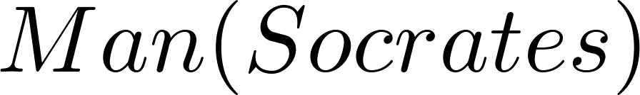
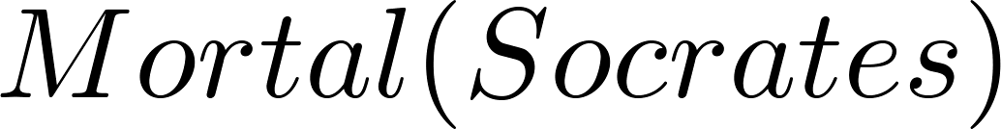
Returning to the Socrates Example
Introduce the propositional functions Man(x) denoting “x is a man” and Mortal(x) denoting “x is mortal.” Specify the domain as all people.
The two premises are:
The conclusion is:
Later we will show how to prove that the conclusion follows from the premises.

Slide 23
Equivalences in Predicate Logic
Statements involving predicates and quantifiers are logically equivalent if and only if they have the same truth value
for every predicate substituted into these statements and
for every domain of discourse used for the variables in the expressions.
The notation S ≡T indicates that S and T are logically equivalent.
Example: ∀x ¬¬S(x) ≡ ∀x S(x)

Slide 24
Thinking about Quantifiers as Conjunctions and Disjunctions
If the domain is finite, a universally quantified proposition is equivalent to a conjunction of propositions without quantifiers and an existentially quantified proposition is equivalent to a disjunction of propositions without quantifiers.
If U consists of the integers 1,2, and 3:
Even if the domains are infinite, you can still think of the quantifiers in this fashion, but the equivalent expressions without quantifiers will be infinitely long.

Slide 25
Negating Quantified Expressions
Consider ∀x J(x)
“Every student in your class has taken a course in Java.”
Here J(x) is “x has taken a course in Java” and
the domain is students in your class.
Negating the original statement gives “It is not the case that every student in your class has taken a course in Java.” This implies that “There is a student in your class who has not taken a course in Java.”
Symbolically ¬∀x J(x) and ∃x ¬J(x) are equivalent

Slide 26
Negating Quantified Expressions
∀ x ∈ Z⁺ , x>3
Some of x is member of positive integers,
P(x) = x>3 (this is false because 0, 1 and 2 also come in positive integers.
We can negate this statement as follows:
∃x ∈ Z^{+ , x <= 3, now ~P(x)} = ^{x <= 3}
Symbolically ¬∀x J(x) and ∃x ¬J(x) are equivalent

Slide 27
Negating Quantified Expressions (continued)
Now Consider ∃ x J(x)
“There is a student in this class who has taken a course in Java.”
Where J(x) is “x has taken a course in Java.”
Negating the original statement gives “It is not the case that there is a student in this class who has taken Java.” This implies that “Every student in this class has not taken a course in Java”
Symbolically ¬∃ x J(x) and ∀ x ¬J(x) are equivalent

Slide 28
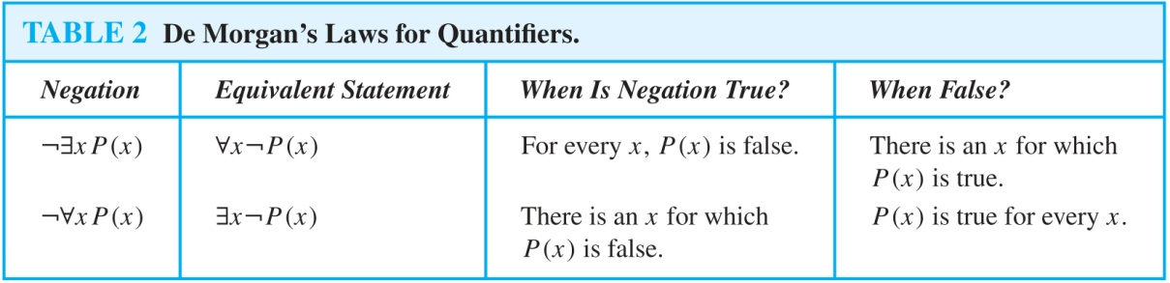
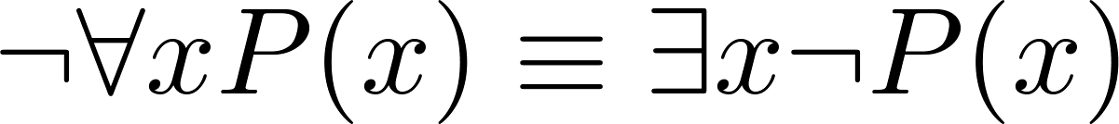
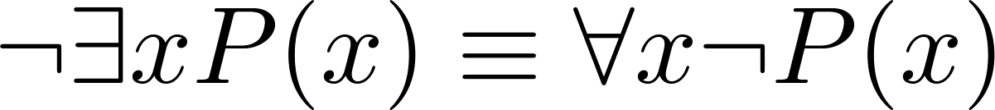
De Morgan’s Laws for Quantifiers
The rules for negating quantifiers are:
The reasoning in the table shows that:
These are important. You will use these.

Slide 29
Translation from English to Logic
Examples:
“Some student in this class has visited Mexico.”
Solution: Let M(x) denote “x has visited Mexico” and S(x) denote “x is a student in this class,” and U be all people.
∃x (S(x) ∧ M(x))
“Every student in this class has visited Canada or Mexico.”
Solution: Add C(x) denoting “x has visited Canada.”
and U be all people.
∀x (S(x)→ (M(x)∨C(x)))

Slide 30
Some Fun with Translating from English into Logical Expressions
U = {Nitwits, Blubbers, Oddments}
F(x): x is a Nitwit
S(x): x is a Blubber
T(x): x is a Oddment
Translate “Everything is a Nitwit”
Solution: ∀x F(x)

